Slide 1
SSI Wallet For Marketplaces
OP Financial Group

Slide 2

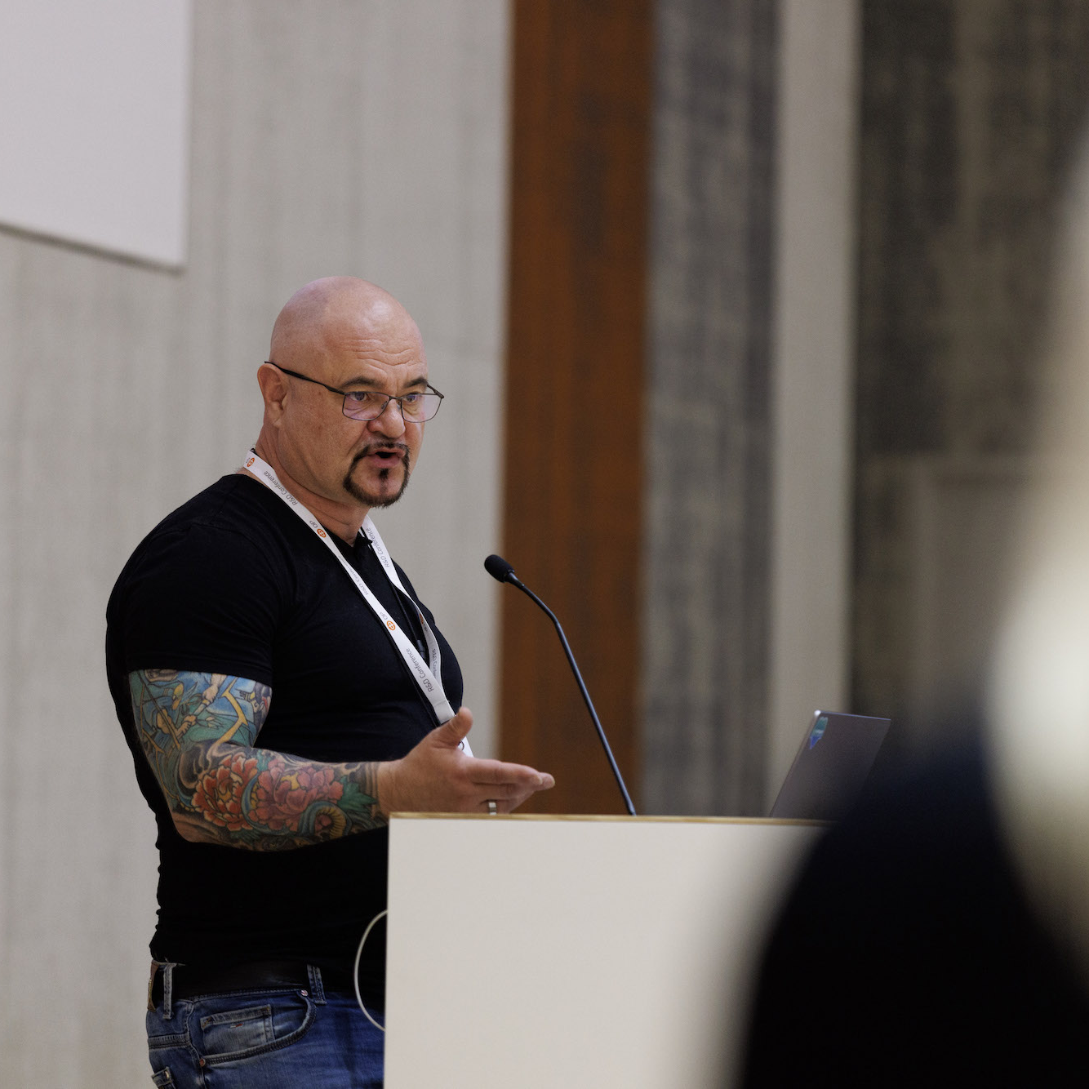
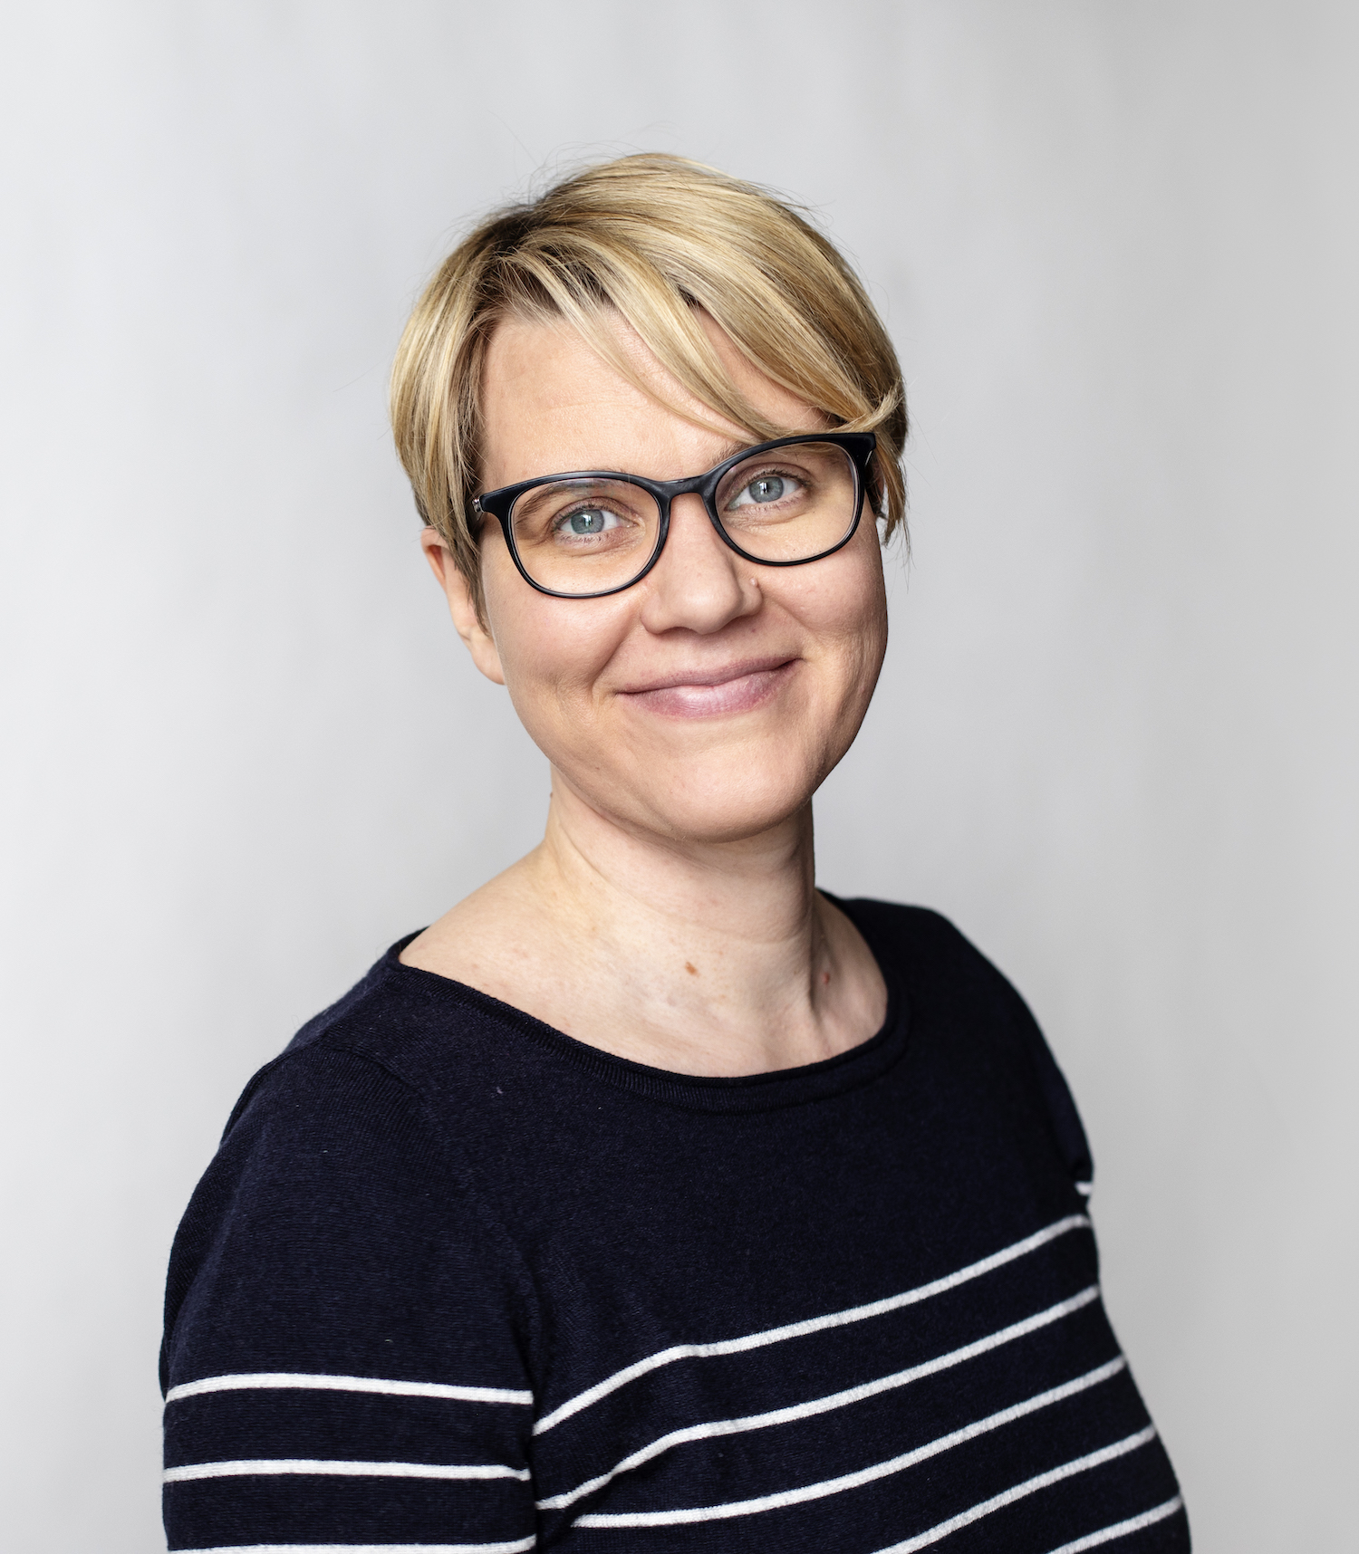
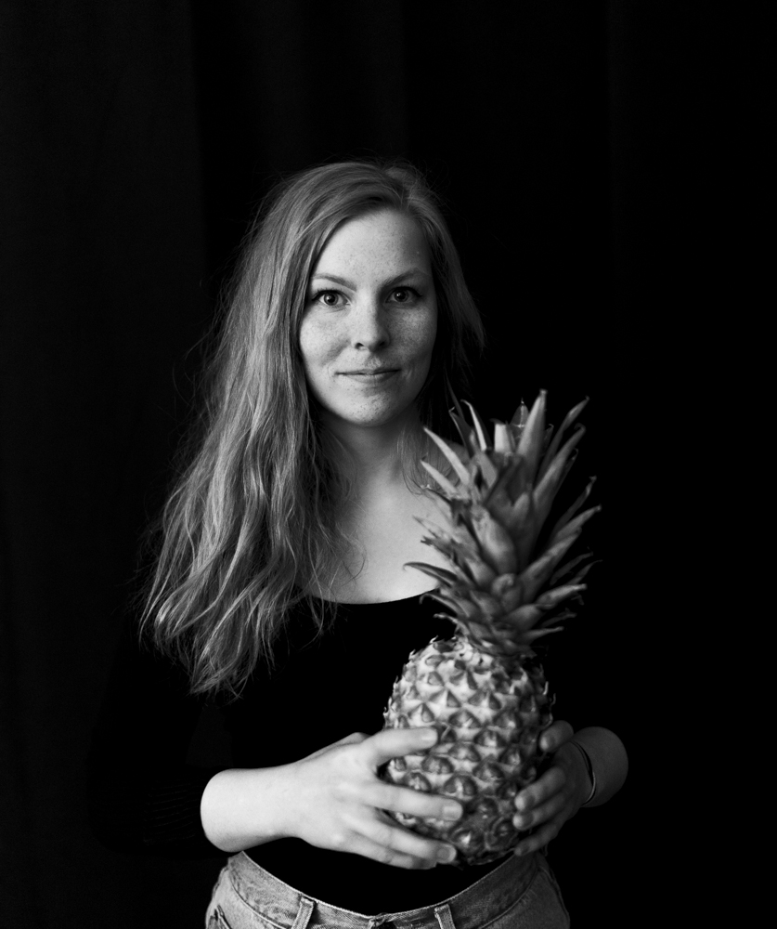
Your Team at OP Financial Group
Aleksi Jalmanen
Product Owner,
Data Engineer
Harri Launio Senior Technology Strategist
Laura Vuorenoja Senior Technology Strategist
Greetta Heilala Experimentation Designer

Slide 3
See you soon!

